Slide 1


Plant disease detection sustainable agriculture
Student -ID:STU67222fa504dd01730293669

Slide 2

Learning Objectives
Understand Plant Disease Detection Methods: Familiarize yourself with traditional and modern techniques for detecting plant diseases, including visual inspection, laboratory testing, and AI-powered methods ¹.
Grasp AI and Machine Learning Fundamentals: Learn the basics of artificial intelligence, machine learning, and deep learning to understand how they can be applied to plant disease detection ¹.
Study Image Processing and Analysis: Understand how image processing and analysis techniques can be used to detect plant diseases from images ¹.
- Explore Sustainable Agriculture Practices: Learn about sustainable agriculture practices and how plant disease detection can be integrated into these practices.
GOAL
Source :
www.freepik.com/

Slide 3
Tools and Technology used
Artificial Intelligence (AI) and Machine Learning (ML): AI and ML can be used to develop models that can detect plant diseases from images ¹.
- Deep Learning (DL): DL models such as Convolutional Neural Networks (CNNs) can be used to detect plant diseases from images ¹.
Image Processing and Analysis Software: Software such as OpenCV, MATLAB, and Python libraries like scikit-image can be used to process and analyze images of plants to detect diseases¹.
Drones and Satellite Imaging: Drones and satellite imaging can be used to capture images of plants and detect diseases ¹.
- Internet of Things (IoT) Sensors: IoT sensors can be used to collect data on environmental conditions and plant health, which can be used to detect diseases

Slide 4
Methodology
Literature Review: Conduct a literature review to understand the current state of plant disease detection in sustainable agriculture.
2. Data Collection: Collect data on plant diseases using various methods such as image capture, sensor data, and manual surveys.
3. Data Preprocessing: Preprocess the data by cleaning, transforming, and formatting it for analysis.
4. Model Development: Develop machine learning models using the preprocessed data to detect plant diseases.
5. Model Evaluation: Evaluate the performance of the machine learning models using metrics such as accuracy, precision, and recall.
6. Deployment: Deploy the machine learning models in a real-world setting using mobile apps, drones, or satellite imaging.
7. Monitoring and Evaluation: Monitor and evaluate the performance of the plant disease detection system in the real-world setting.

Slide 5
Problem Statement:
Plant diseases are a major threat to global food security, causing significant crop losses and economic damage. Traditional methods of plant disease detection, such as visual inspection and laboratory testing, are time-consuming, labor-intensive, and often inaccurate. Furthermore, the increasing use of chemical pesticides and fungicides has negative environmental and health impacts.

Slide 6
Solution:
Plant Disease Detection System
1. Take a photo of the affected plant using a smartphone.
2. Upload the photo to a cloud-based platform.
3. AI-powered algorithm analyzes the photo to detect diseases.
4. Disease diagnosis and recommendations are sent to the farmer's smartphone.
Benefits
Early disease detection
2. Accurate disease diagnosis
3. Reduced chemical use
4. Increased crop yields
Tools Needed
Smartphone with camera
2. Cloud-based platform
3. AI-powered algorithm
4. Internet connectivity

Slide 7
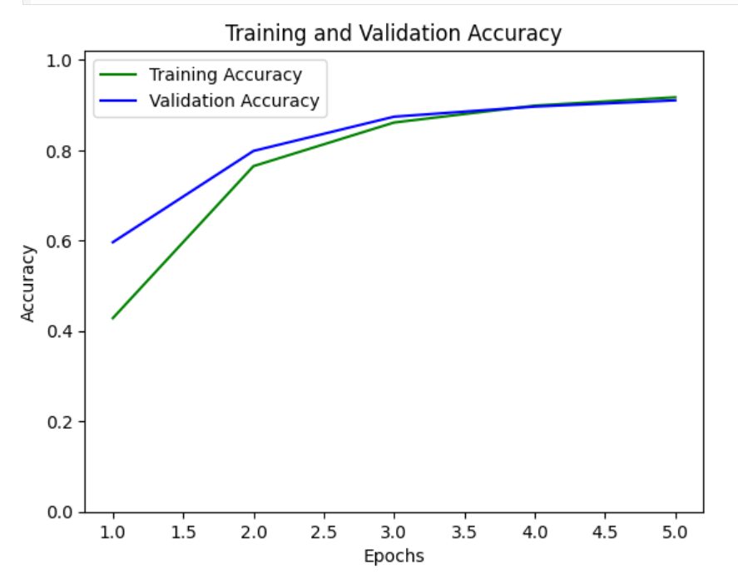
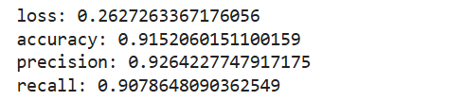
Screenshot of Output:

Slide 8
Conclusion:
Plant disease detection is a critical component of sustainable agriculture, enabling farmers to identify and manage diseases effectively, reducing crop losses and environmental impact. The proposed solution, leveraging AI-powered image analysis and cloud-based platforms, offers a scalable, efficient, and accurate approach to disease detection.

